Slide 1







Enterprise Blockchain Developers (Intermediate)
In support of
Powered By

Slide 2
Outline
What is Hyperledger Fabric
The Infrastrcture Component
Component Explanation
The Architeture
Architeture Explanation
The Transaction Process
Process Explanation
© 2017-2020 SmartMesh Foundation Pte. Ltd. | MeshBox Foundation Pte. Ltd.

Slide 3
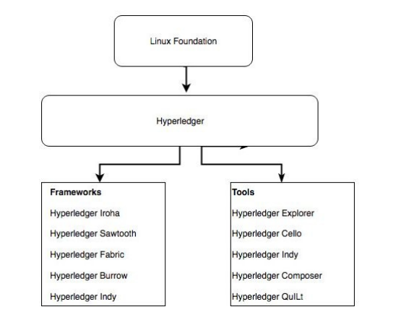
HyperLedger Family

Slide 4
What is HyperLedger
Hyperledger Iroha: Iroha, designed for mobile development projects, is based on Hyperledger Fabric and was contributed by Soramitsu, Hitachi, NTT Data, and Colu. It features modern, domain-driven C++ design as well as a new chain-based Byzantine fault tolerant consensus algorithm called Sumeragi.
Hyperledger Sawtooth: Sawtooth was contributed by Intel and includes a novel consensus algorithm that Intel came up with that's called Proof of Elapsed Time (PoET). PoET aims to achieve distributed consensus as efficiently as possible. Hyperledger Sawtooth has potential in many areas, with support for both permissioned and permissionless deployments and recognition of diverse requirements. Sawtooth is designed for versatility.
Hyperledger Burrow, which was contributed by Monax and Intel initially, is a modular blockchain that was client-built to the specification of the Ethereum Virtual Machine (EVM).

Slide 5
What is HyperLedger
Hyperledger Fabric, contributed by IBM, is designed to be a foundation for developing applications or solutions with a modular architecture. It allows for plug-and-play components, such as consensus and membership services, and leverages containers to host smart contracts called chaincode that comprise theapplication logic of the system.
Hyperledger Indy: Contributed initially by the Sovrin Foundation, Indy is a Hyperledger project made to support independent identity on distributed ledgers. Hyperledger Indy provides tools, libraries, and reusable components for providing digital identities rooted on blockchains.

Slide 6
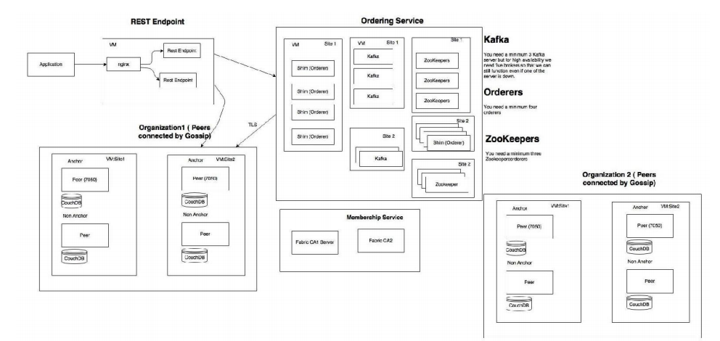
The Infrastructure Component

Slide 7
Conpoment Explaination
Hyperledger Fabric CA
is an implementation of membership services but is not required to be used (that is, any X509-based PKI infrastructure that can issue EC certificates can be used) Dedicated orderer nodes Implements atomic broadcast API Orders and batches transactions and signs each batch (block) to create
Dedicated orderer nodes
Implements atomic broadcast API
Orders and batches transactions and signs each batch (block) to create a hash chain
Hyperledger Fabric provides two implementations—Solo (for dev/test) and a Kafka-based implementation for production/fault tolerance
The ordering service is pluggable—the implementer needs to only provide an atomic broadcast API based on the gRPC interface definition
Peers are now responsible for existing smart logic (chaincode) and maintaining the ledger
Endorsement simulates transactions (that is, it executes them, but does not commit them)
Peers receive batches of endorsed transactions from the orderer nodes and then validate and commit transactions (this eliminates non- determinism)

Slide 8
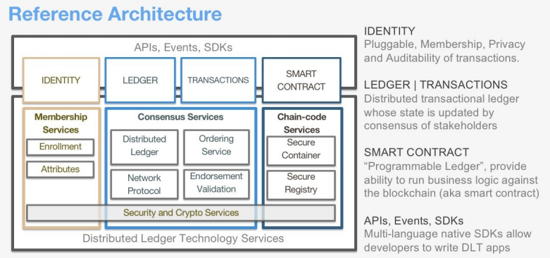
The Architecture

Slide 9
Architeture Explanation
Membership services: This module is essentially a permissioning module and acts as a vehicle to establish a root of trust during network creation, but this is also instrumental in ensuring and managing the identity of members. Membership services are essentially a certificate authority as well as utilized elements of the public key infrastructure (PKI) for things such as key distribution, management, and establishing federated trust as the network grows. The membership services module provides a specialized digital certificate authority for issuing certificates to members of the blockchain network, and it leverages cryptographic functions provided by Hyperledger Fabric.
Transactions: A transaction is a request to the blockchain to execute a function on the ledger. The function is implemented by a chaincode. Cryptography ensures integrity of transactions by linking the transaction to previous blocks and ensuring the transactional integrity, if protected, by linking the cryptogram or hash from previously linked blocks. Each channel in Hyperledger Fabric is its own blockchain.

Slide 10
Architeture Explanation
Smart contract or chaincode services: Chaincode is an application-level code stored on the ledger as a part of a transaction. Chaincode runs transactions that may modify the world state. Transaction logic is written as chaincode (in the Go or JavaScript languages), and executes in secure Docker containers. The transaction transforms data, scoped by chaincode on the channel from which it operates.
Events: The process of validating peers and chaincodes can produce events (pre-defined events and custom events generated by chaincode) on the network that applications may listen for and take actions on. These events are consumed by event adapters, which may further deliver events using vehicles such as WebHooks or Kafka. Fabric-committing peers provide an event stream to publish events to registered listeners. As of v1.0, the only events that get published are Block events. A Block event gets published whenever the committing peer adds a validated block to the ledger:

Slide 11
Architeture Explanation
Consensus: Consensus is at the heart of any blockchain system. It also enables a trust system. In general, the consensus service enables digitally signed transactions to be proposed and validated by network members. In Hyperledger Fabric, the consensus is pluggable and tightly linked to the endorse-order-validation model that Hyperledger proposes. The ordering services in Hyperledger Fabric represent the consensus system. The ordering service batches multiple transactions into blocks and outputs a hash-chained sequence of blocks containing transactions.
Ledger: Another component is a distributed encrypted ledger, including an append-only data store. This provides the ability to query and write data across distributed ledgers. There are two options:
Level DB (default embedded KV DB) supports keyed queries, composite key queries, and key range queries
Couch DB (external option) supports keyed queries, composite key queries, key range queries, plus full data rich queries

Slide 12
Architeture Explanation
Client SDK: A client SDK enables the creation of applications that deploy and invoke transactions atop a shared ledger. The Hyperledger Fabric Reference Architecture supports both Node.js and Java SDK. A software developer kit is like a programming kit or set of tools that provide developers with the environment of libraries to write and test chaincode applications. SDKs are critical in blockchain application development and will be discussed in detail in further chapters. Specific capabilities included in the SDK are the application client, chaincode, users, events, and crypto suite.

Slide 13
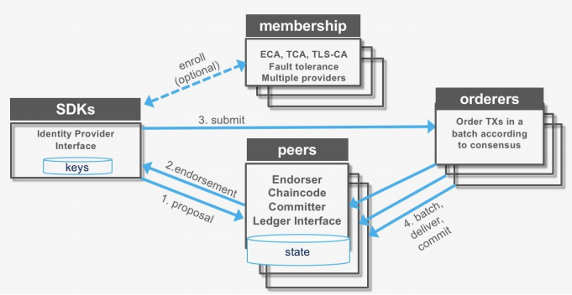
The Transaction Process

Slide 14
Process Explanation
Transaction proposal (application SDK): 1. Transaction proposal is submitted by application SDK 2. It receives a transaction proposal response back (includes ReadWrite set) post endorsement 3. It submits the transaction (includes ReadWrite set) to the ordering service
Transaction endorsement: 1. The transaction is sent to the counter-parties represented by endorsing peers on their channel 2. Each peer executes the transaction by calling the specified chaincode function and signs the result, which becomes the read-write-set of the transaction 3. Each peer may participate in multiple channels, allowing concurrent execution
Transaction submitted to the ordering service: 1. The ordering service accepts endorsed transactions and orders them according to the plug-in consensus algorithm, and then delivers them on the channel 2. Peers on the channel receive transactions and validate before committing to the ledger
Transaction validation: 1. Validates each transaction and commit block 2. Validates the endorsement policy 3. Validates ReadSet versions in state DB 4. Commits the block to blockchain 5. Commits the valid transaction to state DB

Slide 15
Network Demo
https://hyperledger-fabric.readthedocs.io/en/release-2.2/test_network.html
git，cURL：
sudo apt install git
sudo apt install curl
Docker&Docker Compose
https://docs.docker.com/engine/install/ubuntu/
https://docs.docker.com/compose/install/
Pull the images
curl -sSL https://bit.ly/2ysbOFE | bash -s
sudo ./network.sh up
sudo docker ps (check the network component)

Slide 16
network.sh Walk Through
See the Code! it demonstrate the whole process of creating a hyperledger fabric network

